Slide 1
dr. Maša Kovič Dine
Faculty of Law, University of Ljubljana
EU
Environmental Law

Slide 2
European Convention on Human Rights
Right to life (Art. 2)
Right to liberty and security (Art. 5)
Right to a fair trial (Art. 6)
Right to respect for private and family life and home (Art. 8)
Freedom of expression (Art. 10)
Freedom of assembly and association (Art. 11)
Right to an effective remedy (Art. 13)
Protection of property (Art. 1 of Protocol No.1 to ECHR)
Right to clean and healthy environment?

Slide 3
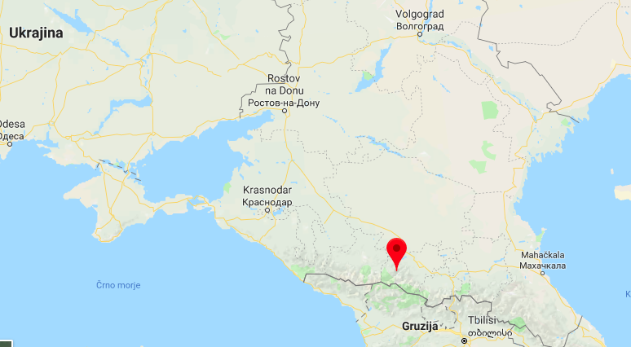
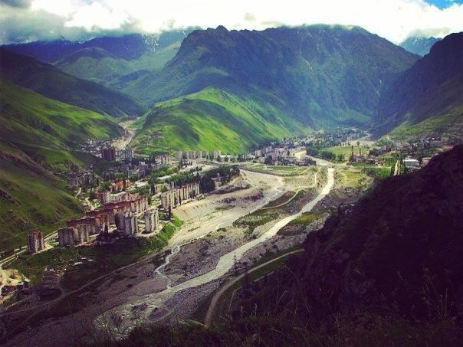
Right to life (Art. 2 ECHR)
Budayeva and others v. Russia
Judgment of 20 March 2008
Mudslide in town Tyrnauzs, Mt. Elbrus
8 killed + injuries + psychological trauma +lost their homes
Violation 2 reasons:
failure to implement land-planning and emergency relief policies > foreseeable risk to the lives of people
Lack of adequate judicial enquiry into the disaster

Slide 4
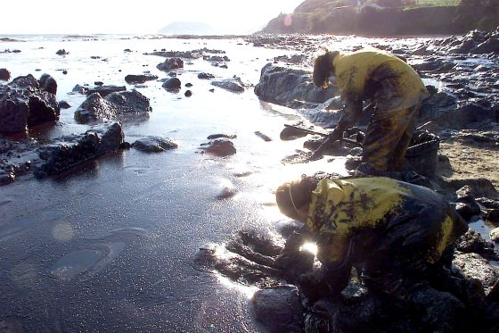
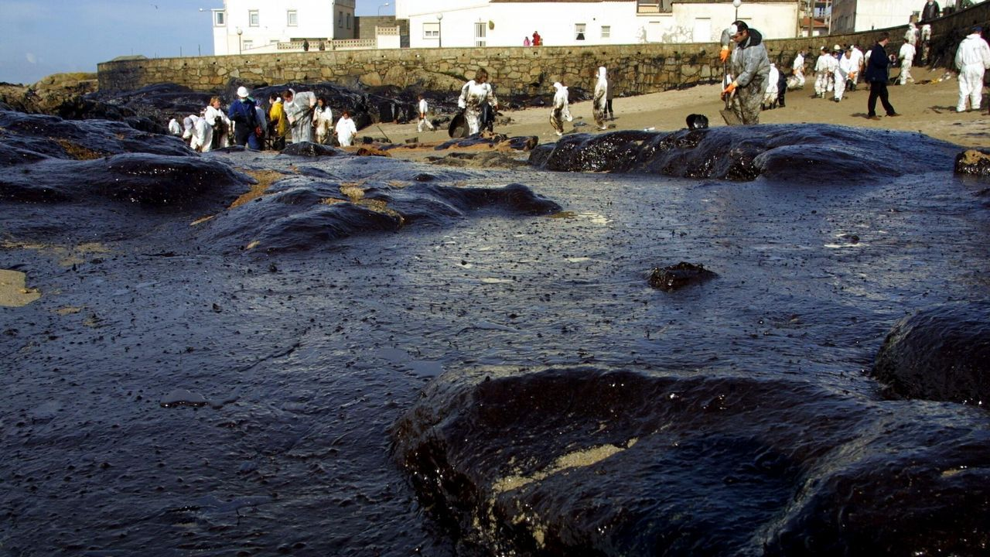
Right to liberty and security (Art. 5 ECHR)
Mangouras v. Spain
Mangouras was a captain of the ship
70,000 tons of fuel oil discharged in the sea off the Spanish coast
Large ecological disaster
Criminal investigation, captain detained with a 3 million bail
“exceptional nature of the case and the huge environmental damage caused by marine pollution on a seldom seen scale”
Agreed with the set amount of bail – in line with the level of liability incurred and to make sure that those responsible had no incentive to evade justice

Slide 5
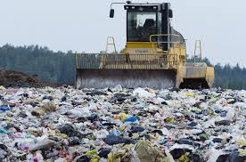
Right to a fair trial (Art. 6 ECHR)
L’Erabliere asbl v. Belgium
Complaint by an environmental non-profit association
Against granting the planning permission to expand a waste collection site
Complaint before the national courts not allowed for procedural reasons, as it did not include a statement of the facts explaining the background to the dispute
Limitation on the right to access to court disproportionate to the requirements of legal certainty and proper administration of justice

Slide 6
Right to respect for private and family life and home (Art. 8 ECHR)
Giacomelli v. Italy
Applicant lived 30m from a plant for storage and treatment of hazardous waste
Plant received permission for detoxification of the waste
Noise and harmful emission a violation to her environment and permanent risk to health and home
Violation of Art. 8
7 years since the operation no EIA was carried out – several concerns with the detoxification process: incompatible with environmental regulations and unsuitable geographic location and a specific health risk to the local residents
Other cases: mobile phone antennas, noise pollution, urban development, water supply contamination

Slide 7
Freedom of expression (Art. 10 ECHR)
Vides Aizsardzibas Klubs v. Latvia
Nongovernmental organization for the protection of environment
Concerns about the conservation of coastal dunes on a stretch of coast in the Gulf of Riga
Allegations that local mayor had facilitated illegal construction
Action for damages for defamation
Violation of Art. 10
Restriction on the freedom of expression not proportionate with the legitimate aim pursued – protection of the environment and the pointing out of the malfunctions in an important sector managed by the local authorities

Slide 8
Protection of property (Art. 1, Protocol No. 1 to the ECHR)
Turgut and others v. Turkey
100,000m² land was transferred to the Public Treasury – the land was considered public forest
Violation of the right to property – no compensation
“Economic imperatives and even certain fundamental rights, including the right to property, should not be placed before considerations relating to environmental protection”
No compensation a disproportionate interference with the right (only in exceptional circumstances)

Slide 9
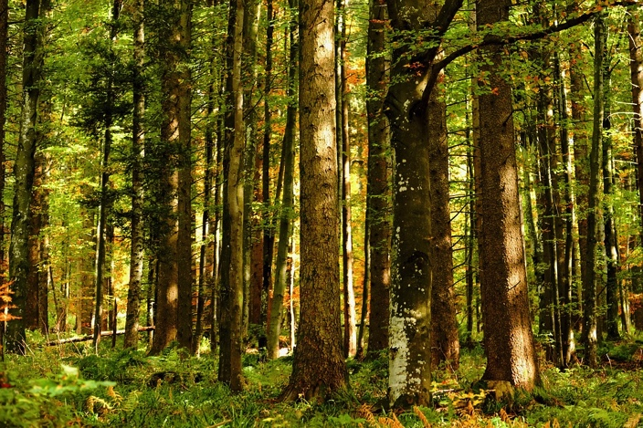
Thank you!
masa.kovic-dine@pf.uni-lj.si

